Slide 1
STAT 301-2 Final Project
Junhua Tan

Slide 2
Introduction of Dataset
Heart Disease Data Set from UCI Machine Learning Repository
Goal: Predict the presence of heart disease in a patient given set of basic information and health conditions (Classification).
13 Predictors
8 categorical variables (mostly with two or three levels)
5 continuous variables
Total of 303 observations
No missing values

Slide 3
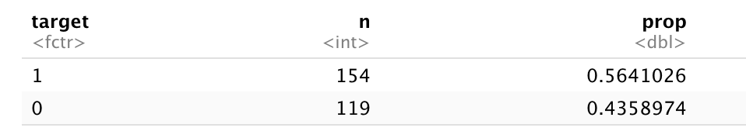
Goal: Predict Heart Disease
Of the training data, 56% of the patients are diagnosed with heart disease.

Slide 4
Exploratory Data Analysis
N = 55
Notes:
split from 20% of the training set (90%)

Slide 5
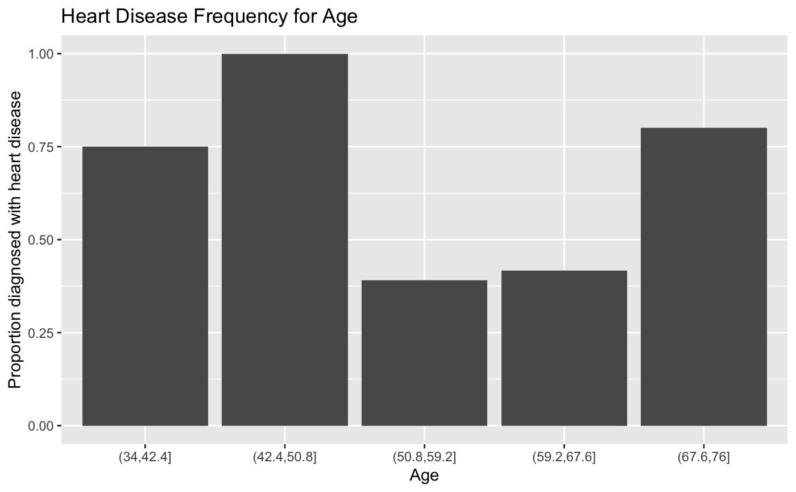
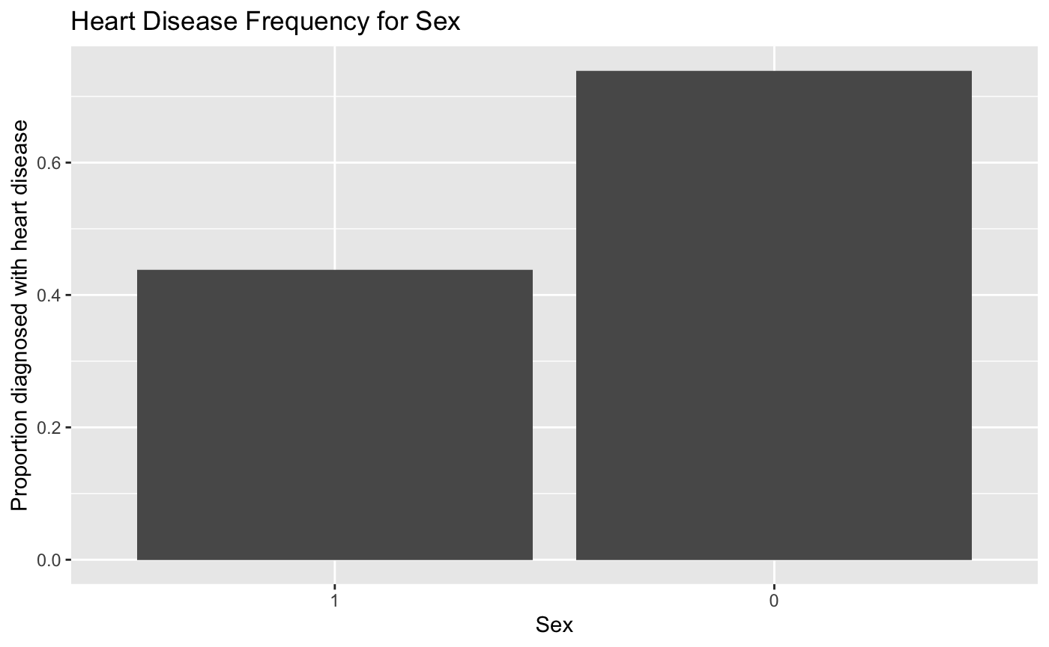
Patient Basic Information
Age: cut into 5 groups 9/9 observations in age group (42.5, 50.8] diagnosed with heart disease
2. Sex (0 = female, 1 = male)
17/23 females are diagnosed with heart
disease
Notes:
Age: continuous -> b/c limited data (only 55) many contains 1 or 2 observations, so I decide to use the cut function to divide them into 5 groups and plot in bar chart as categorical variables
Most risked group: (42.5-50.8] 9/9 observations

Slide 6
Health Condition
Chest Pain Types
Maximum Heart Rate
Exercise-induced ST Depression and Angina

Slide 7
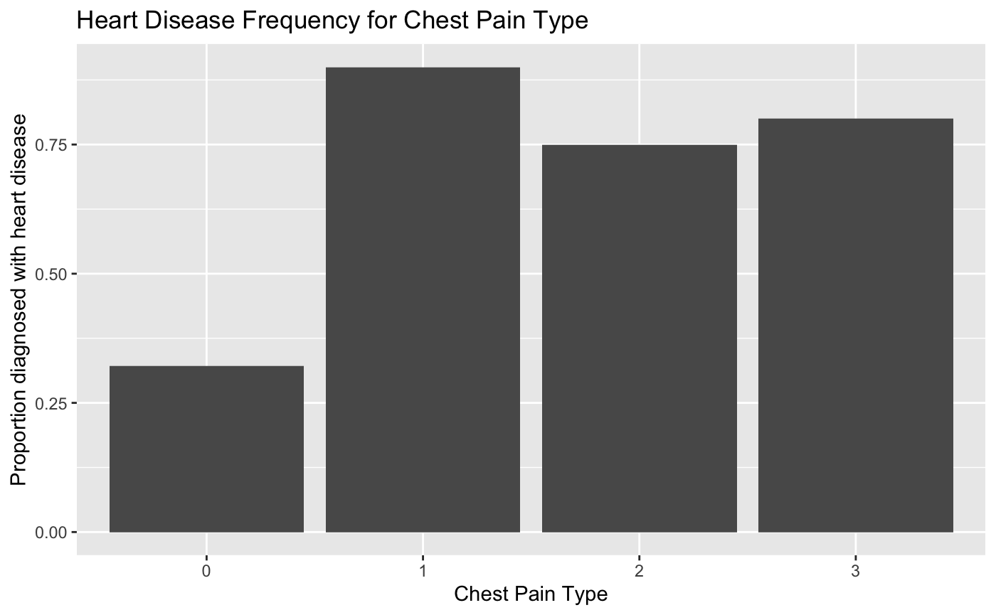
Chest Pain Types
0: Absence, 1-3: various types of chest pain
From the bar chart (right), presence of chest pain seems to correlate with the presence of heart disease.

Slide 8
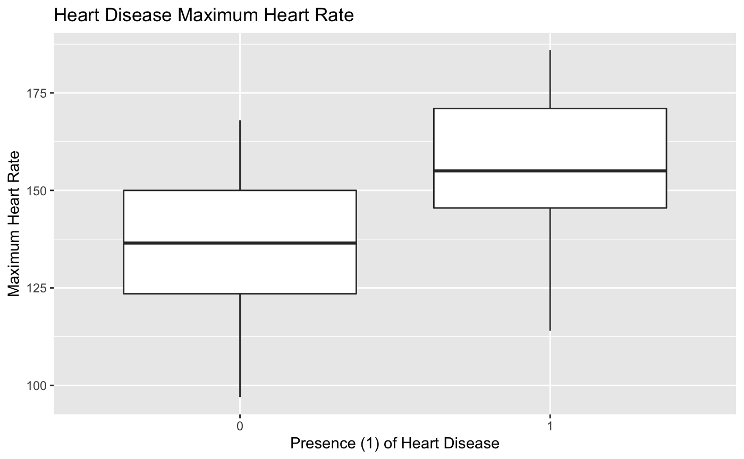
Maximum Heart Rate and Heart Disease
Maximum Heart Rate: continuous variable
From the boxplot, a higher maximum heart rate seems to correlate with the presence of heart disease.

Slide 9
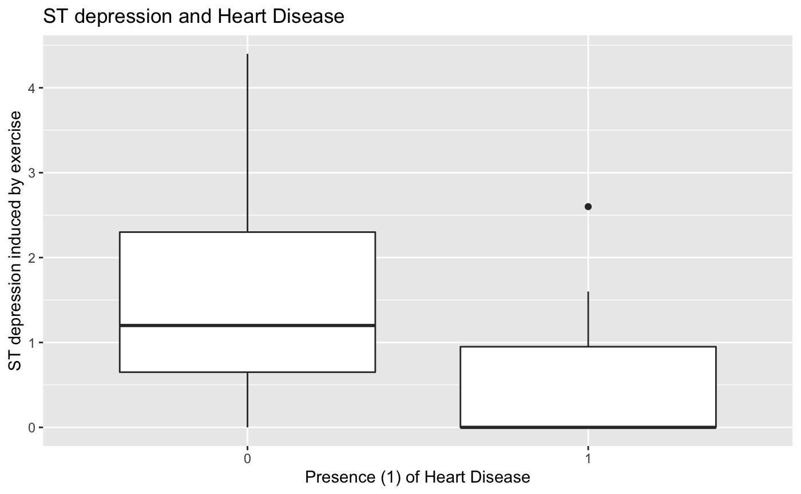
ST Depression Induced by Exercise
ST depression is the abnormally low ST segment below the baseline, indicative of potential ischemia or infarction.
From boxplot (right), Absence of ST depression seems to correlate with the presence of heart disease.

Slide 10
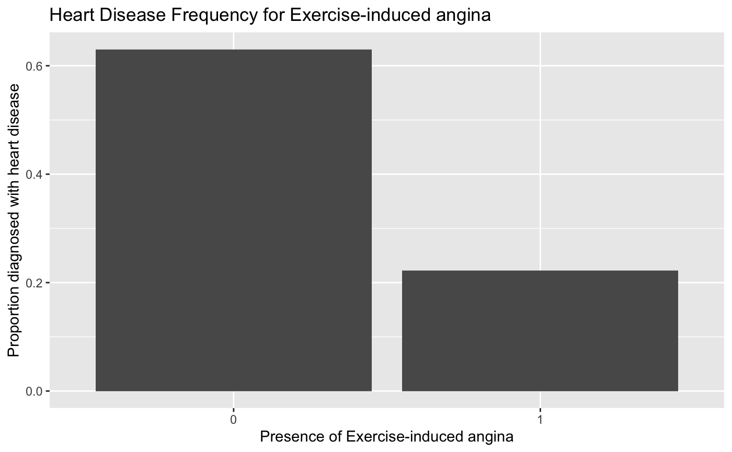
Exercise-induced Angina
Absence of exercise-induced angina seems to also correlate with the presence of heart disease.
**Overall, patients can be tested with exercise to help determine syndromes of heart disease.

Slide 11
Model Building
N = 273

Slide 12
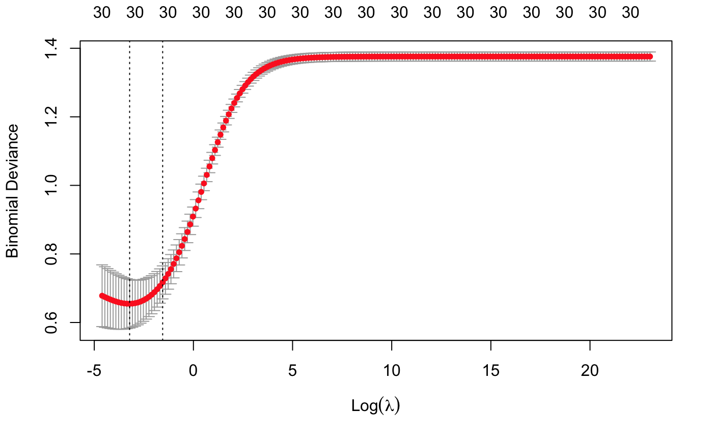
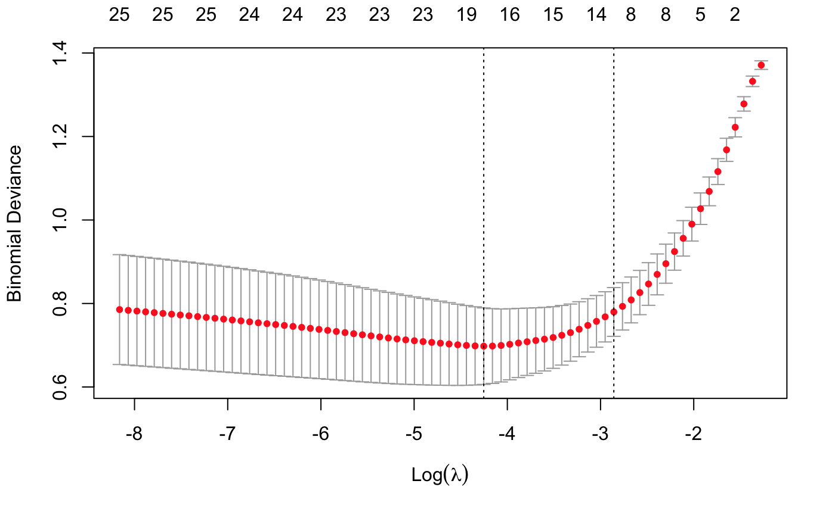
Ridge and Lasso
Ridge
Lasso
Notes:
LASSO Significant variables: sex, cp, thalach, exang, oldpeak, slope, ca, thal
Maybe trestbps, restecg
Interestingly: age is NOT found to be significant here

Slide 13
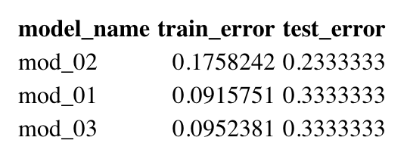
Logistic Model Test Error Rate
Two logistic models with mod_01 (all predictors), mod_02 (predictors I found interesting in EDA), and mod_03 (LASSO predictors)
However, there might be some underlying bias due to the limited data (30 observations in test set).

Slide 14
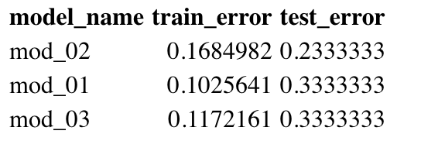
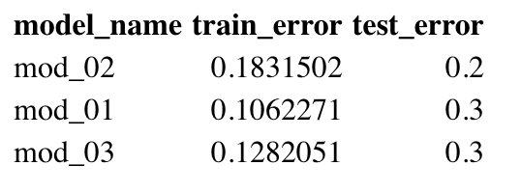
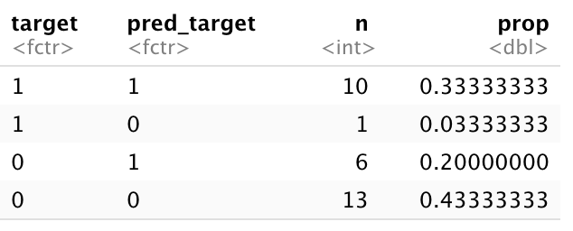
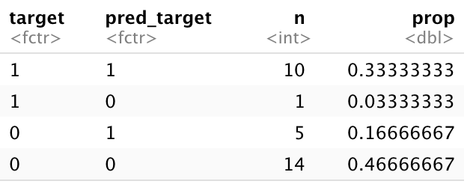
LDA and QDA
LQA
QDA
Notes:
Confusion matrix for LDA shows the model is generally good at picking patients whose health conditions would indicate presence of heart disease; however, it comes at a cost of slightly overestimating the patients who does not have heart disease but is predicted to be (20%).

Slide 15
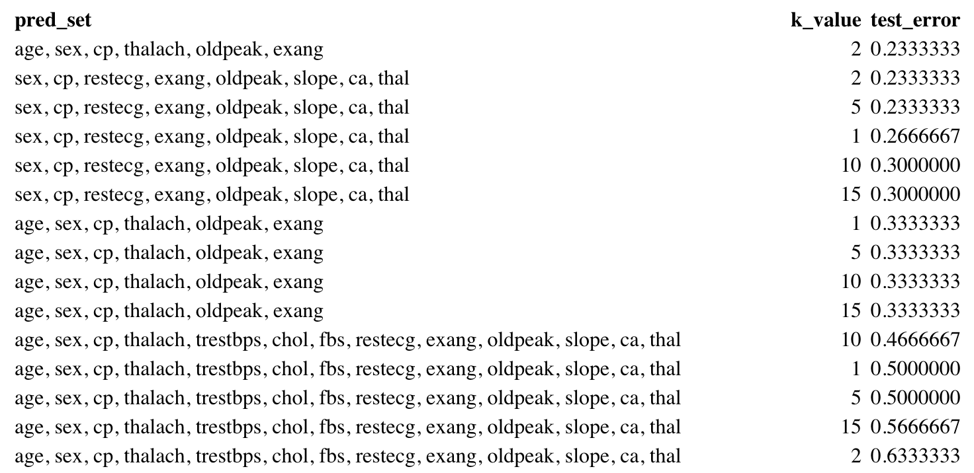
KNN Model Test Error
Notes:
As k increases, test error also increases, and this model works best when k = 2. Thus KNN does not work best for this dataset.
Limited data
Neighbors are too far (b/c limit)
People with similar conditions have different result

Slide 16
Key Takeaway
Next Step
The potential correlations between those theoretically-related predictors seems to fit the model best, yielding smaller test error rates.
QDA models with the six predictors seems to fit best so far.
Select best cut for age
Random forest

Slide 17
Thank you!

Slide 18
Citation
Data source: Janosi A., Steinbrunn W., M.D. (2019). UCI Machine Learning Repository [https://archive.ics.uci.edu/ml/datasets/Heart+Disease]. Irvine, CA: University of California, School of Information and Computer Science.

